Slide 1
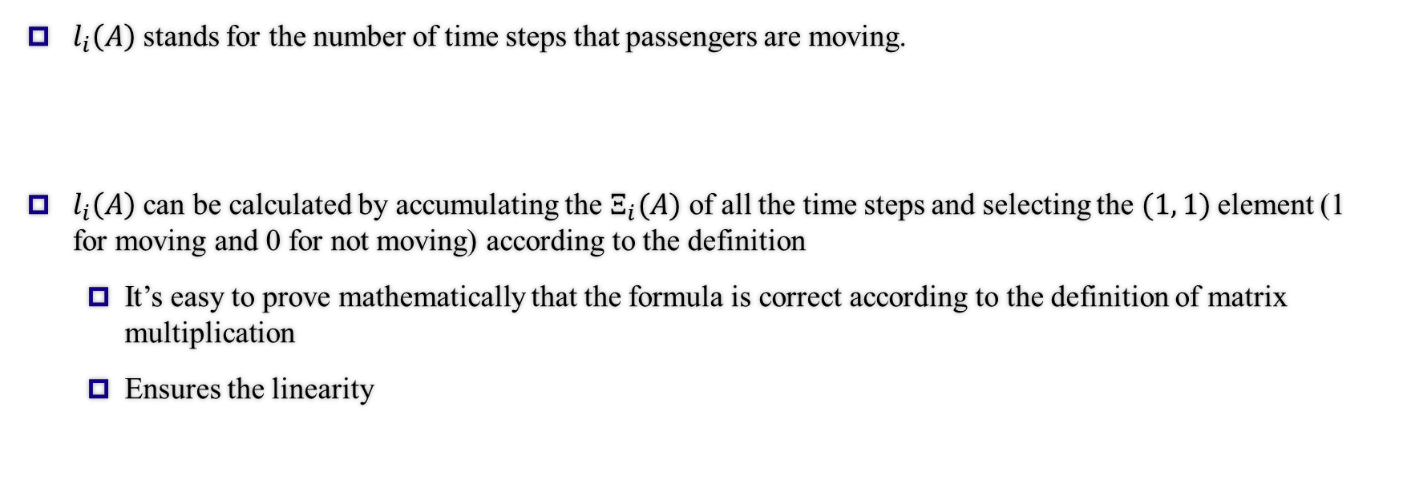

The calculation of $l_{i}(A)$
$l_{i}\left(A\right)$ stands for the number of time steps that passengers are moving.
$l_{i}\left(A\right)$ can be calculated by accumulating the $Ξ_{i}(A)$ of all the time steps and selecting the $(1, 1)$element (1 for moving and 0 for not moving) according to the definition
It’s easy to prove mathematically that the formula is correct according to the definition of matrix multiplication
Ensures the linearity
1

